Slide 1
SEMI SUPERVISED
VIDEO SEMANTIC RECOGNITION
Anuj Baranwal – 12IT09
Rohit Kumar – 12IT62
Siddharth Ramakrishnan – 12IT79

Slide 2
INTRODUCTION
Presence of many high level features for videos – Curse of Dimensionality Problem - Overfitting.
Need for dimensionality reduction.
Feature Selection – High accuracy and quick computation
Time consuming to manually annotate.
Solution : Semi Supervised Learning

Slide 3
LITERATURE SURVEY
Paper | Advantages | Disadvantages
Semi supervised learning literature survey | Needs less labelled data which otherwise is very expensive and more unlabelled data which is cheap Semi-supervised learning requires less human effort and gives higher accuracy, it is of great interest both in theory and in practice | Semi Supervised learning make a lot of assumptions Some techniques require very specific setup Frequent problem with noisy labels There is no free lunch
A short introduction to boosting | It is fast, simple and easy to program. It has no parameters to tune (except for the number of round T ). It requires no prior knowledge about the weak learner and so can be flexibly combined with any method for finding weak hypotheses. | AdaBoost can be sensitive to noisy data and outliers. In some problems, however, it can be less susceptible to the overfitting problem than most learning algorithms.
Paper | Disadvantages
 | Semi Supervised learning make a lot of assumptions Some techniques require very specific setup Frequent problem with noisy labels There is no free lunch
A short introduction to boosting | AdaBoost can be sensitive to noisy data and outliers. In some problems, however, it can be less susceptible to the overfitting problem than most learning algorithms.

Slide 4
LITERATURE SURVEY
Semi Supervised feature selection via Spline Regression | Dimensionality reduction Stability and calculation simplicity. Sets of linear equations which should be solved to construct splines are very well-conditioned, therefore, the polynomial coefficients are calculated precisely. The calculation scheme stays stable even for big N. The construction of spline coefficients table is performed in O(N)time, and interpolation – in O(log(N)) time. | Function is forced fit the data exactly. In general it can be assumed that the data include error. B-Splines have the advantage over ordinary Splines that the sensitivity decreases as more data points are in each section. But if there are too many datapoints in each section the interpolation worsens. The interpolation can turn into a curve that is far of all the points, does not even follow any trend
Semi Supervised feature selection for Graph classification | Great performance if graph fits the tasks Can be used in combination with any model Explicit mathematical formulation | Problem occur if graph does not fit the task Hard to construct graph in sparse spaces

Slide 5
OUTCOME
Semi Supervised feature selection
Computations faster along with maintaining accuracy
Preserving data distribution and local geometry using Spline Regression – feature selection
Graph based and AdaBoost learning algorithms to be used
Very suitable for video data sets

Slide 6
PROBLEM STATEMENT AND OBJECTIVES
Problem Statement
Given a large set of labeled and unlabeled training videos where num(labeled) << num(unlabeled), apply semi supervised learning techniques to train them and subsequently classify test videos
Objectives
Key Frames and Feature Extraction
Feature Reduction using Spline Regression
Graph based semi supervised learning algorithm implementation
AdaBoost Semi Supervised algorithm implementation
Statistical Analysis of Results

Slide 7
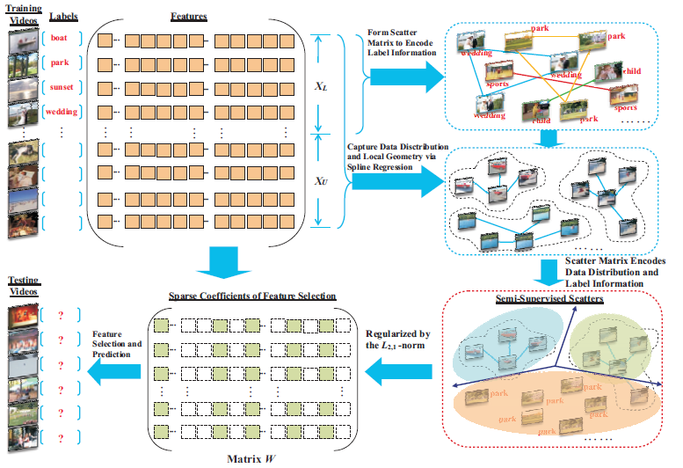
RESEARCH METHODOLOGY

Slide 8
RESEARCH METHODOLOGY
Key Frame and Feature Extraction
Datasets – Human(12), Building data(11) Nature data(11) – 3 vids labelled in each.
Initial Key Frame Extraction using OpenCV, 150 frames for a 6 second video. Need to reduce.
FilmStrip.py – Preprocess the video to make all the frames finish within a second. Extracting frames now result in 28 frames max per video.

Slide 9
RESEARCH METHODOLOGY
Feature Extraction
Feature matrix : N*F*V where N-num of vids , F – num of frames per vid, V-feature vector. (34,28,9)
  Dimension 1,2 – Mean Red , STD Red:
1) RGB Images. Variation in intensities
2) Image broken into 3 independent color planes. Extract mean red intensity and Standard Deviation
Dimensions 3,4 - Mean Green, STD Green
Dimensions 5,6 – Mean Blue, STD blue
Obtained in a similar manner

Slide 10
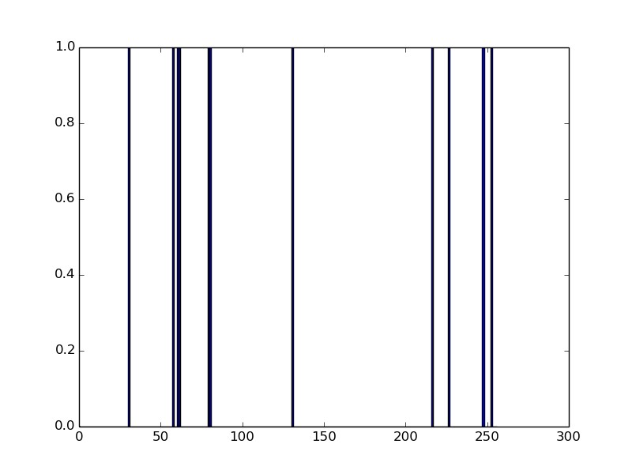
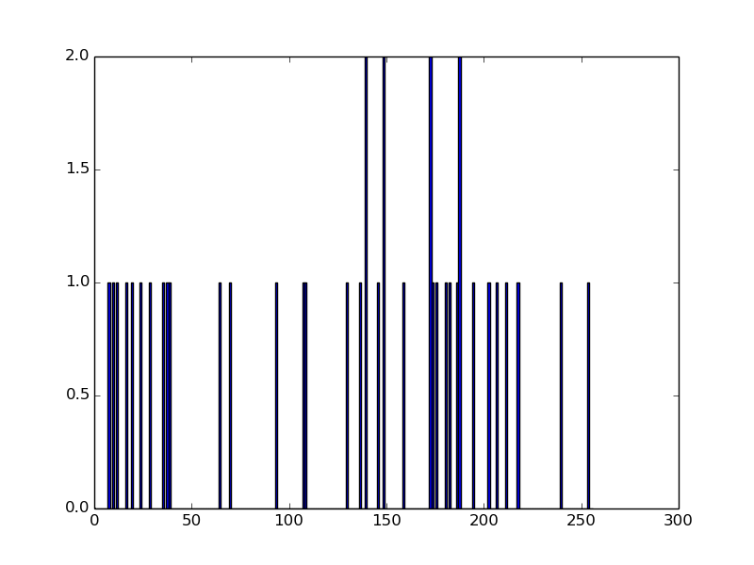
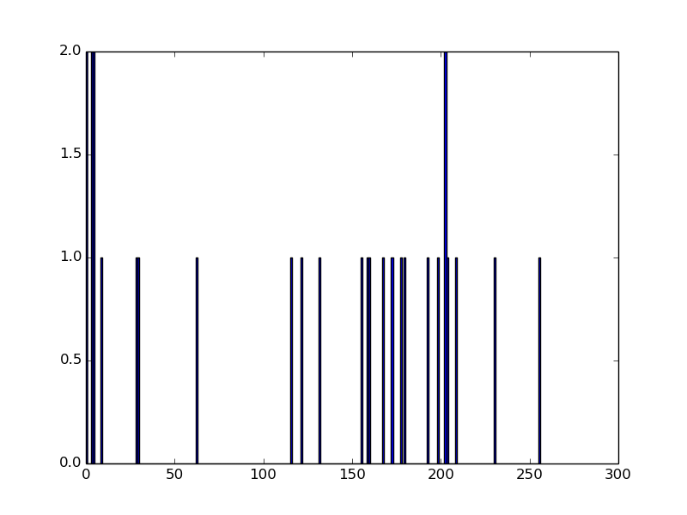
RESEARCH METHODOLOGY
Dimension 7 – Shannon’s Entropy : Texture
Color Histograms :
Bins : 0-255 (256 bins)
Split into color planes and calculate their respective color histograms.
Blue Hist Green Hist Red Hist

Slide 11
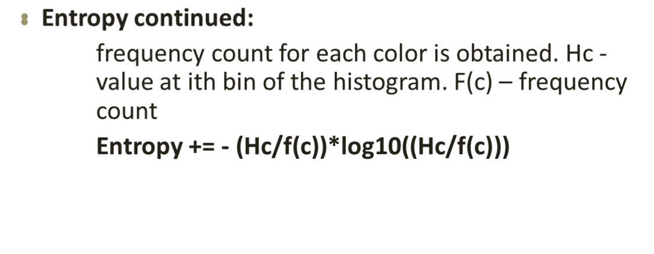
RESEARCH METHODOLOGY

Slide 12
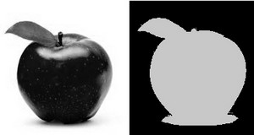
RESEARCH METHODOLOGY
Dimension 8 – White Contribution:
White – Foreground and Black – Background. Calculate percentage of white
Thresholding:
After Thresholding
Original

Slide 13
RESEARCH METHODOLOGY
Dimension 9 – Count Objects
Abstract concept- no such documentation available
Modify known algorithms to obtain a count (Slightly inaccurate)
2D Convolution and Median Blurring :
1) low pass filters - removes noise, blurs
2) convolution matrix is created and is applied to the image matrix along with specified operation
3) convolution Kernel is LPF – removes substantial amount of noise.
Thresholding : Next Step

Slide 14
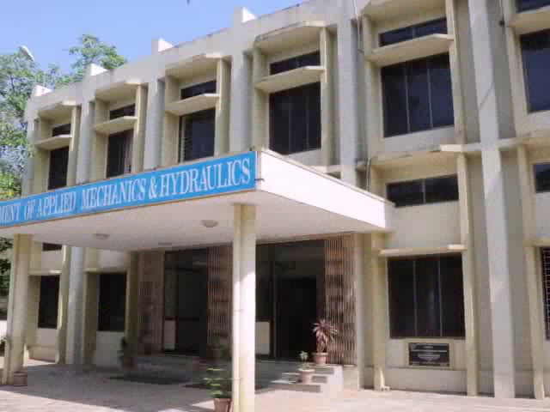

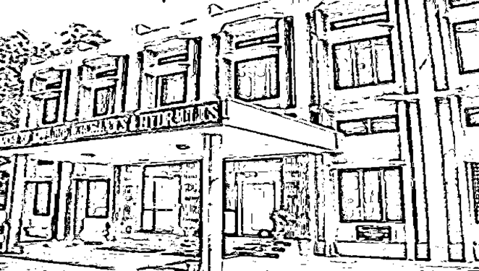
RESEARCH METHODOLOGY
Contours :
1) curve joining all the continuous points, having same color or intensity.
    2) Tool for object detection and recognition
    3) For better accuracy - thresholding to obtain binary images
    Original Blurred Image Threshold

Slide 15
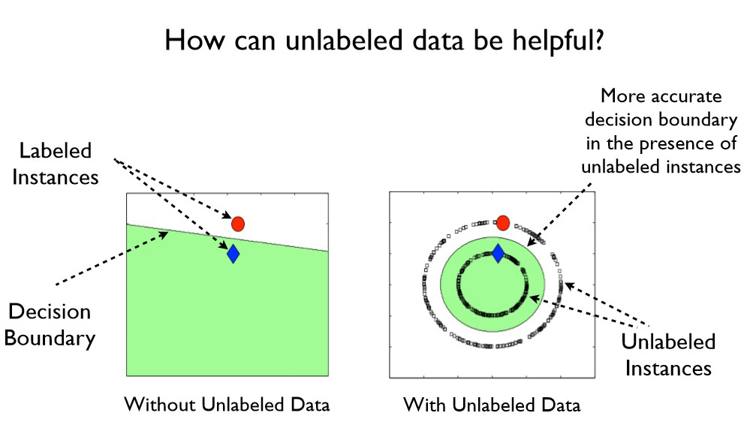
RESEARCH METHODOLOGY
Graph Algorithm:
Labeled and the unlabeled nodes are represented as vertices in a weighted graph, and edges encode the similarity between the nodes connecting them.
Proposed in terms of a random Gaussian field on the graph, where the mean field - harmonic functions - using the matrix operations and the associated methods.

Slide 16
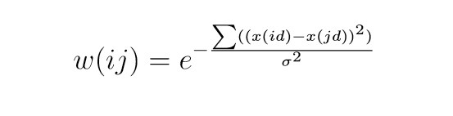
RESEARCH METHODOLOGY
l labeled points (x1,y1)…(xl,yl) and u unlabeled points x(l+1)…x(l+u),such that l << u and n = l+u
Connected graph G = (V,E) where V : n data points, with nodes L=1,...,l corresponding to the labeled points with labels y1, ..., yl, and nodes U=l+1,…, l+u corresponding to the unlabeled points.
Task - assign labels to nodes U
Assume n * n symmetric weight matrix W on the edges of the graph.
Nearby points in Euclidean space are assigned large edge weight.
Compute f :V−> R on G and assign labels based on f.

Slide 17

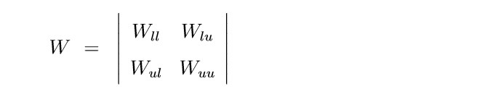
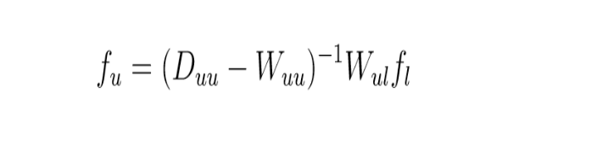
RESEARCH METHODOLOGY
f to take values from the unique class points that must have been assigned to one of the labels and not otherwise.
L = D−W where L is the Laplacian Matrix, D is the diagonal matrix such that each of the diagonal element gives the sum(Wij) where j = 1,2,3,...,n. L represents the del.

Slide 18
RESEARCH METHODOLOGY
PRINCIPLE COMPONENT ANALYSIS
Highlight their similarities and differences. Since patterns in data
Lack of graphical representation
Quick Calculation and perhaps better visualisation
Steps Followed
Calculate mean vector
Calculate Scatter/Covariance Matrix
Find Eigen Values and Eigen Vectors and sort. Pick k components
Transform the input matrix with the help of the matrix generated in 3
Result : A new reduced dimension matrix is obtained => n*d has now become n*k where k<d

Slide 19
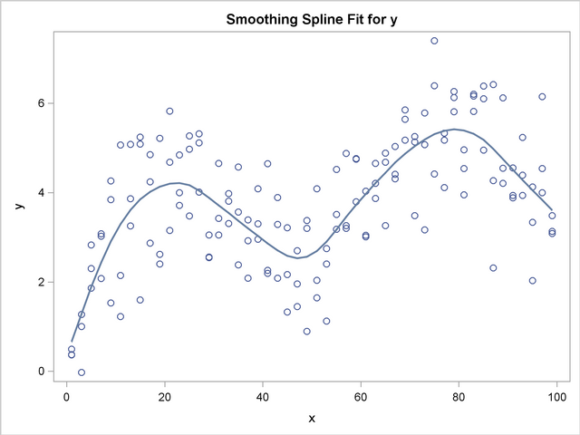
Spline Regression
Cubic Splines:
  1) lowest degree polynomial to support an inflection
  2) well behaved numerically - curves will usually be smooth
  3)To make more complex curves - piecewise curve fitting and parameterization.
4)Disadvantage – Tendency to overfit.
5)Fix – Choose control points wisely to make it more general

Slide 20
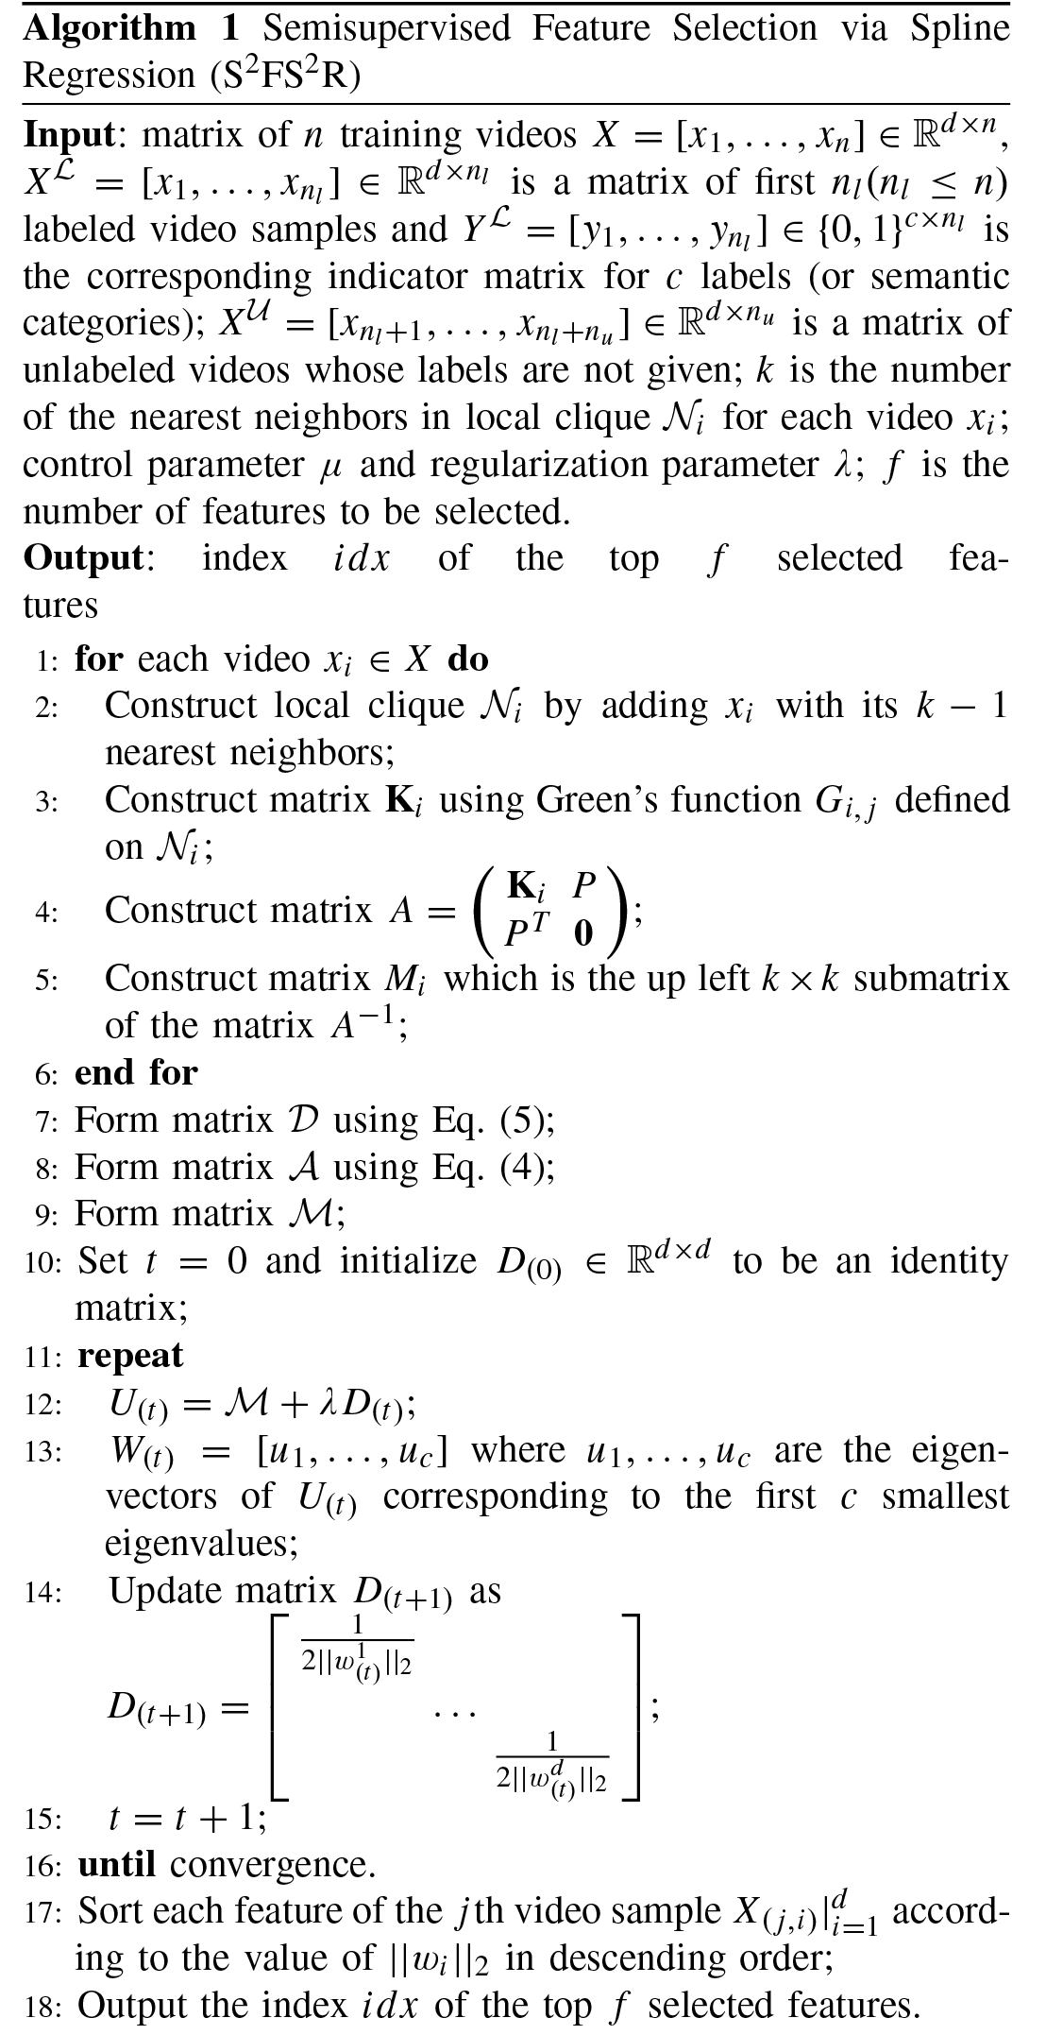

Slide 21
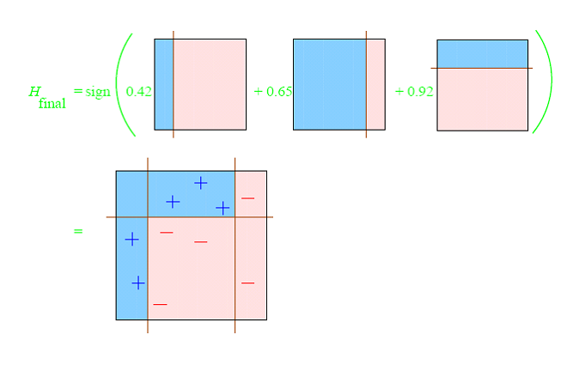
ADABOOST
Combine multiple weak classifier into a single classifier
Helps choose training set for each new classifier based on result from previous classifier. Weight added to each classifier

Slide 22
ADABOOST
Training set selection
Classifier Output Weights
Vector of weights with one weight for each training example in the training set = Output of final classifier

Slide 23
Multi Class Adaboost

Slide 24
RESULTS OBTAINED
created a feature matrix corresponding to each video example
Completed PCA on the resultant data set
Graph algorithm completed with accuracy improvement from 75 to 85 %
Implemented Adaboost prototype

Slide 25
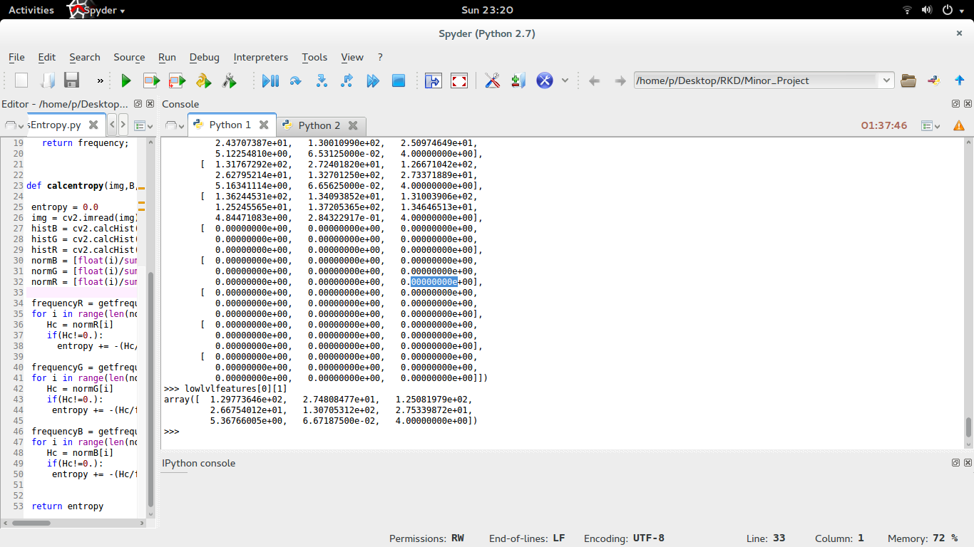
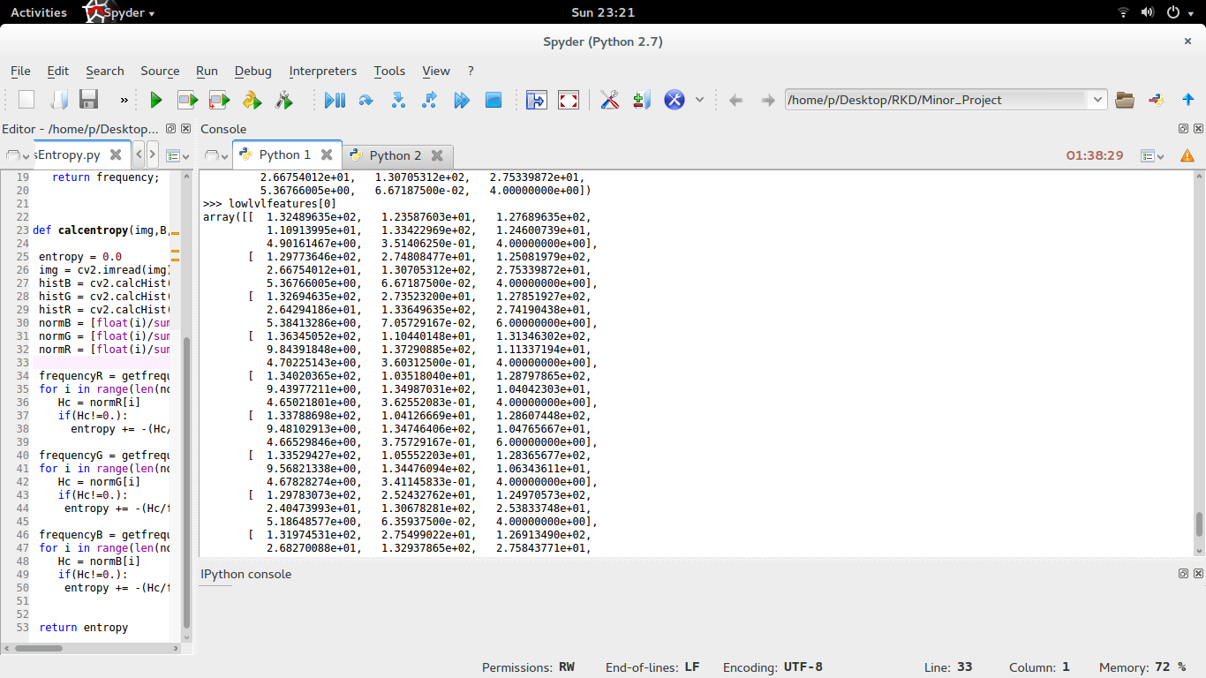
RESULTS OBTAINED

Slide 26
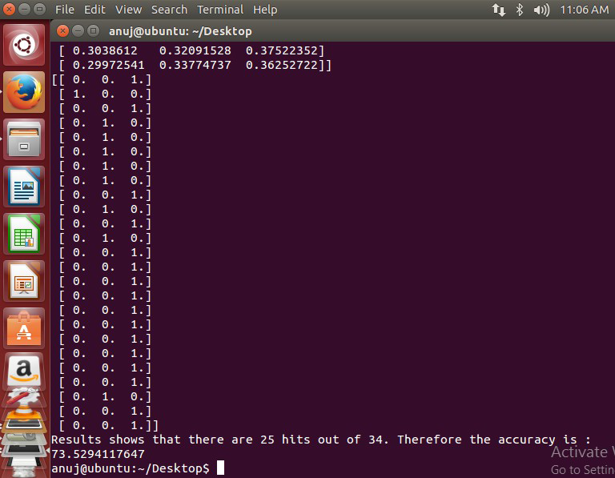
RESULTS OBTAINED
Accuracy of training set approx. 75 %

Slide 27
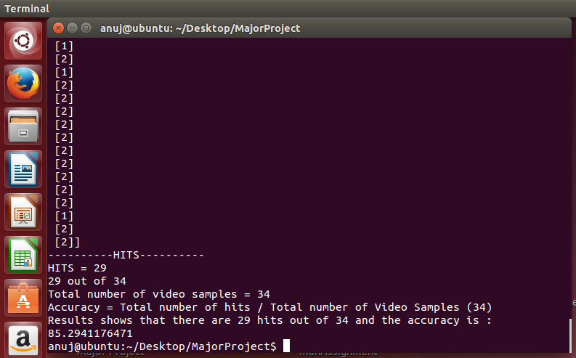
RESULTS OBTAINED

Slide 28
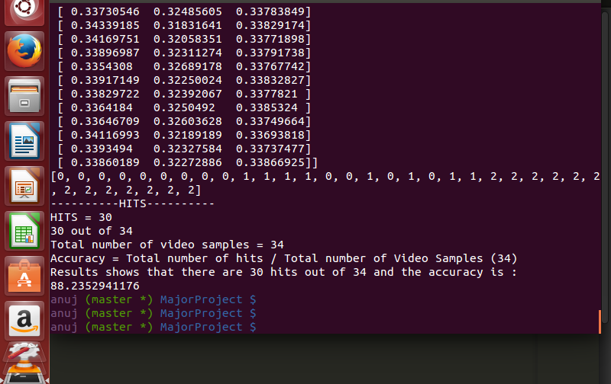
RESULTS OBTAINED

Slide 29
CONCLUSION AND FUTURE WORK
Conclusion :
  Keyframe and feature extraction has been completed a along with the graph learning algorithm.
  Accuracy of training set has increased to about 85%
  PCA has been implemented with reduced dimensionality. Accuracy – 88%
  Adaboost prototype has been built. Accuracy - 88%
Future Work :
Work on the convergence of spline regression and get reduced features.
Fine tune parameters and test for large dataset and include more number of classes.
Create a search UI for displaying

Slide 30
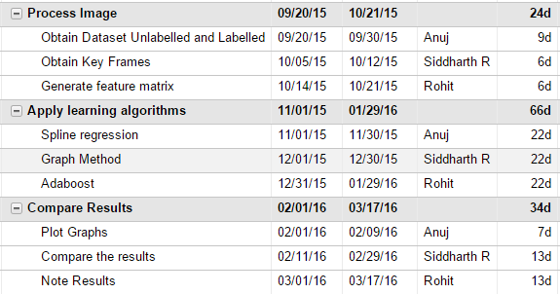
TIMELINE AND INDIVIDUAL CONTRIBUTION
Individual Contribution :
Anuj Kumar – Graph Algorithm,Literature Survey,Adaboost
Siddharth P – KeyFrame Extraction, Feature Extraction,Spline Regression,PCA
Rohit Kumar – Feature Extraction,Literature Survey,Adaboost

Slide 31
REFERENCES
[1] R. Ewerth and B. Freisleben
Semi-supervised learning for semantic video retrieval in Proceedings of the 6th ACM
International Conference on Image and Video Retrieval 2007, pp. 154 161.
[2] Yahong Han, Yi Yang, Yan Yan, Zhigang Ma, Nicu Sebe, Xiaofang Zhou
Semisupervised Feature Selection via Spline Regression for Video Semantic Recognition
IEEE TRANSACTIONS ON NEURAL NETWORKS AND LEARNING SYSTEMS, VOL. 26, NO. 2, FEBRUARY 2015
[3] Andrew Goldberg and Xiaojin Zhu
Seeing stars when there aren't many stars: Graph-based semi-supervised learning for
sentiment categorization. In HLT-NAACL 2006 Workshop on Textgraphs: Graph-based Algorithms for Natural Language Processing, New York, NY, 2006.
[4] Xiaojin Zhu, John Laerty, and Zoubin Ghahramani
Semi-supervised learning: From Gaussian elds to Gaussian processes.Technical Report CMU-CS-03-175, Carnegie Mellon University, 2003.
[5] S. Dagtas, W. Al-Khatib, A. Ghafoor, and R. L. Kashyap
Models for motion-based video indexing and retrieval IEEE Transactions on Image Processing pp. 88 101, 2000.
[6] Y. Yang, H. Shen, Z. Ma, Z. Huang, and X. Zhou
2,1-norm regularized discriminative feature selection for unsupervised learning
Twenty-Second International Joint Conference on Artical Intelligence (IJCAI-11) 2011, pp. 1589 1594.

